Slide 1

Smart Shoe for Wireless Ground Reaction Force Monitoring using
Pressure Sensors and Machine Learning
Dhruv Shambhu Thakkar
(Research Intern, HCR Lab, IIT Gandhinagar)
Indian Institute of Technology Gandhinagar

Slide 2
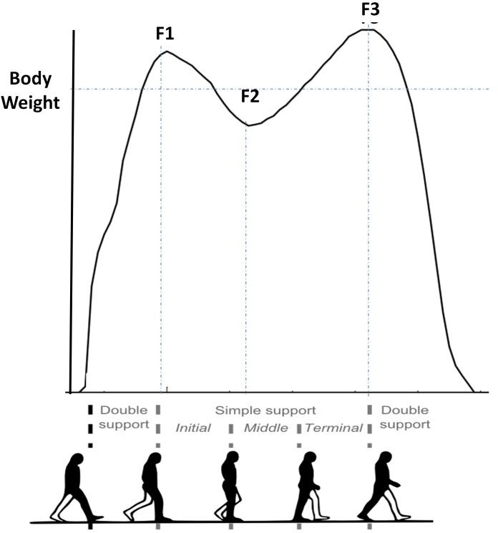
Introduction
What is Ground Reaction Force?
GRF is the force exerted by the ground on a body in contact with it.
Why do we need to monitor GRF ?
Insights into biomechanics of Human Movement
(Gait Analysis, Balance Control, Force/Load Distribution)
Assessment & Identification of abnormalities & asymmetries ( joint loadings, altered force patterns etc)
Injury Prevention, Performance Optimization, Rehabilitation
Assistive Device Design Improvement
[1]
[1] Bonnefoy-Mazure, A. & Armand, Stéphane. (2015). Normal gait.

Slide 3
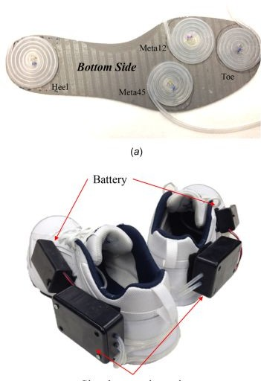
Literature Review
1. A Wireless Human Motion Monitoring System for Smart Rehabilitation:
The study introduces a wireless human motion monitoring system designed for gait analysis and visual feedback in rehabilitation training.
The system incorporates inertial sensors and smart shoes with pressure sensors to capture lower-extremity joint rotations and measure force distributions during walking.
The raw measurement data is used to calculate gait phases, step lengths, and center of pressure (CoP) to assess abnormal walking behaviors.
User interfaces were developed & results demonstrated that patients could comprehend the visual feedback and achieved comparable training performance to traditional gait training with physical therapists.
Overall, the research paper presents a promising wireless monitoring system that enables effective gait analysis and rehabilitation training.
[2]
[2] Zhang, Wenlong, Masayoshi Tomizuka, and Nancy Byl. "A wireless human motion monitoring system for smart rehabilitation." Journal of Dynamic Systems, Measurement, and Control 138.11 (2016).

Slide 4
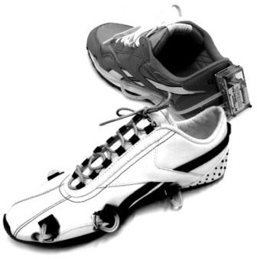
Literature Review
2. A Wireless Human Motion Monitoring System for Smart Rehabilitation:
The paper introduces a new analysis method that utilizes fuzzy logic to continuously and smoothly detect gait phases, enabling a comprehensive utilization of GCF sensor information.
Additionally, the paper presents a higher-level algorithm that quantitatively monitors abnormalities in human gait, including improper GCF patterns and incorrect gait phase sequences.
The proposed methods are implemented using sensor-embedded shoes, referred to as smart shoes, which feature four GCF sensors installed between the cushion pad and the sole.
Overall, the research paper introduces an approach to gait monitoring using air pressure sensors and provides insights into the detection of gait phases and abnormalities, offering potential applications in advanced rehabilitation systems.
[3]
[3] Kong, Kyoungchul, and Masayoshi Tomizuka. "A gait monitoring system based on air pressure sensors embedded in a shoe." IEEE/ASME Transactions on mechatronics 14.3 (2009): 358-370.

Slide 5
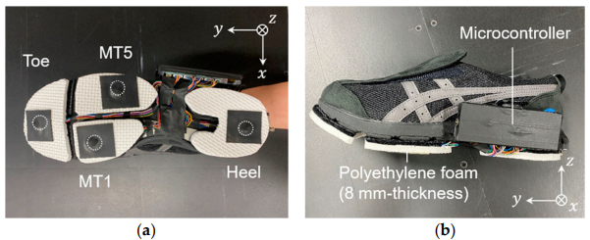
Literature Review
3. This work develops a shoe sole sensor system with high-capacity, compact triaxial force sensors to estimate three-directional ground reaction forces (GRFs) during walking and turning movements. By utilizing Cr–N strain-sensitive thin films mounted at key points on the shoe sole, the system captures detailed GRF data, which is then processed using machine learning models, including multiple linear regression (MLR) and Gaussian process regression (GPR). The results demonstrate that the GPR model effectively predicts GRFs in the y and z directions with a prediction error of less than 15%, showing strong agreement with force plate measurements
[3]
[5] Prediction of Three-Directional Ground Reaction Forces during Walking Using a Shoe Sole Sensor System and Machine Learning

Slide 6
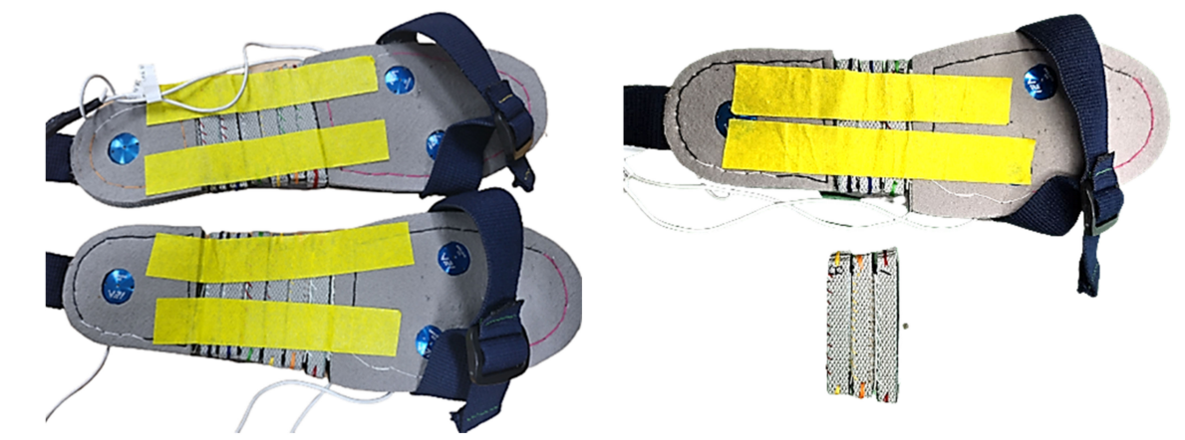
Literature Review
3. This paper presents a method for estimating three-axis ground reaction forces (GRFs) during walking using shoes equipped with three uniaxial EzForce-1D optical load cells and a sequence-to-sequence Long Short-Term Memory(seq2seq LSTM) model. The load cells, placed on the 1st metatarsal, 5th metatarsal, and mid-heel regions, were designed to minimize distortion and adapt to different foot sizes. The collected data was used to predict vertical, anterior-posterior (AP), and medial-lateral (ML) GRFs. The experiment involved 81 healthy adults walking at their preferred speed, with GRF measured using force plates as a reference. The LSTM model was trained with resampled and filtered data from 109 sets and validated with separate test sets.
[3]
[6] A Deep Learning Model for 3D Ground Reaction Force Estimation Using Shoes with Three Uniaxial Load Cells

Slide 7
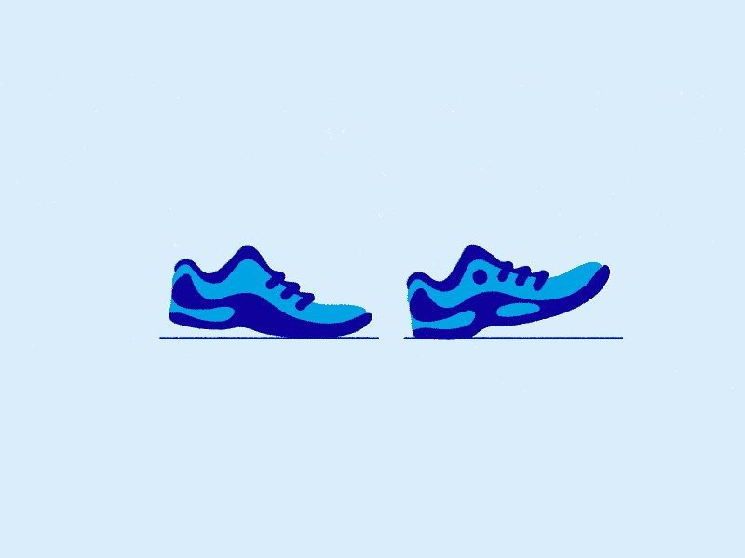
Motivation
Smooth and Continuous Gait activity & GRF detection
Pressure map with individual raw sensor readings: Heat Map for Loading and Force distribution
Wireless & Portable Analysis:
Convenient for End User to monitor daily life activities
Exploring and Leveraging ML techniques in predicting real time GRF
Inexpensive alternative for existing technologies
Various uses in Rehabilitative and assistive research
Indian Institute of Technology Gandhinagar

Slide 8

Objective
The objective of this study is to demonstrate the development and application of a wireless and portable system to predict real-time Ground Reaction Forces through machine learning techniques while providing an inexpensive alternative for existing technologies, and exploring its potential in rehabilitative and assistive research.
Indian Institute of Technology Gandhinagar

Slide 9
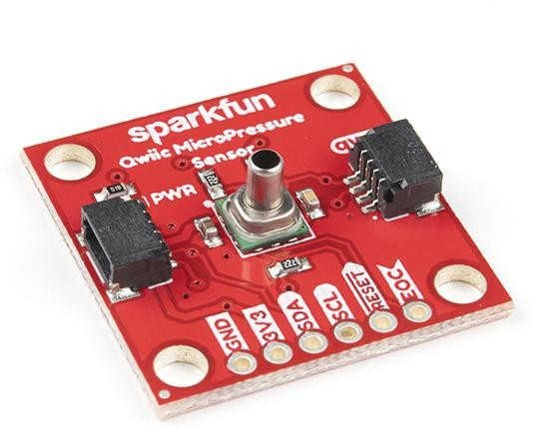
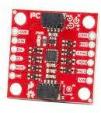
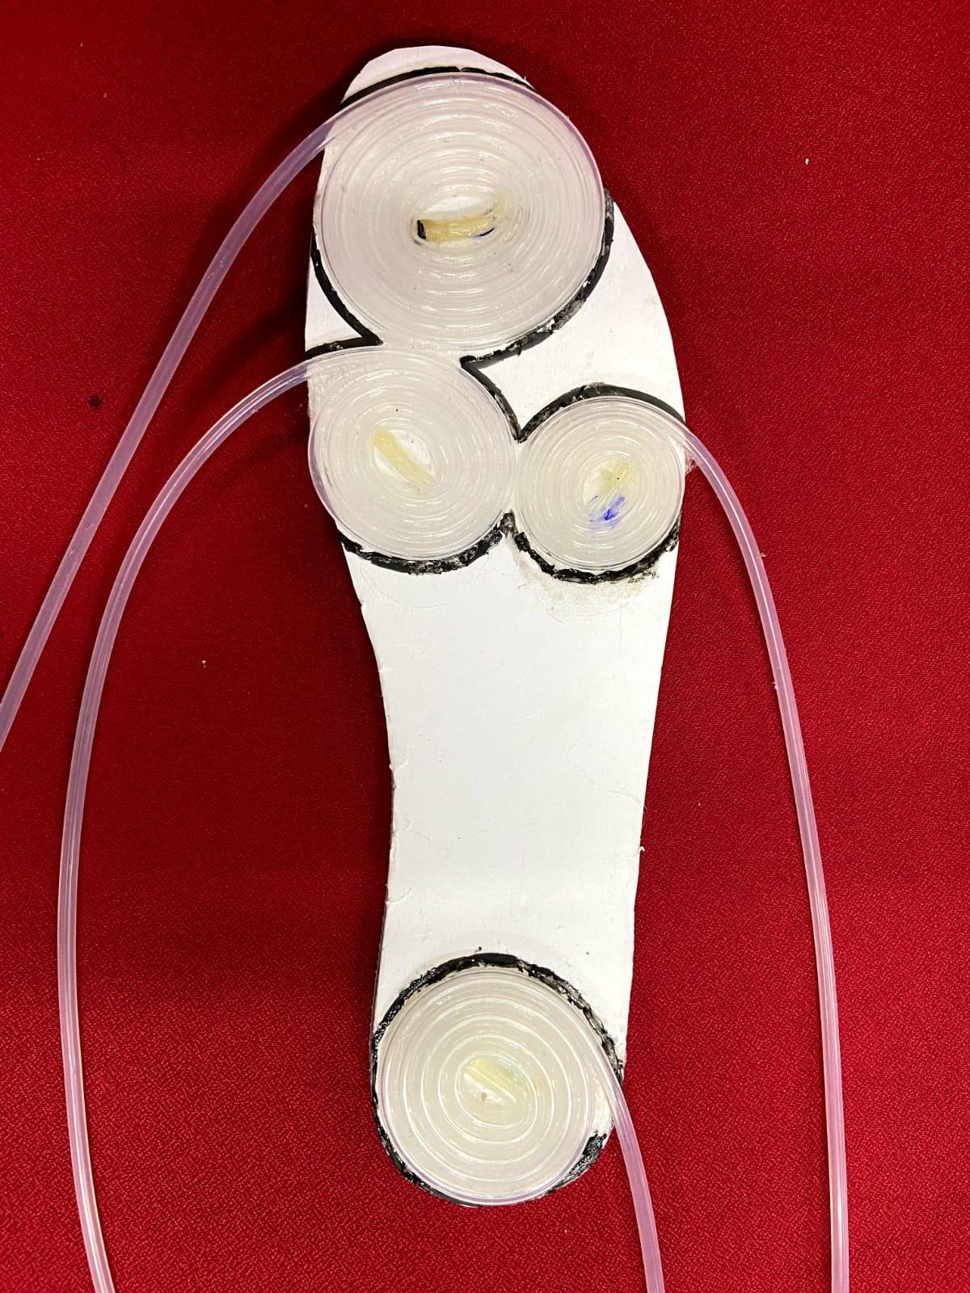
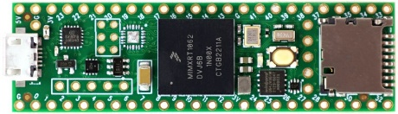
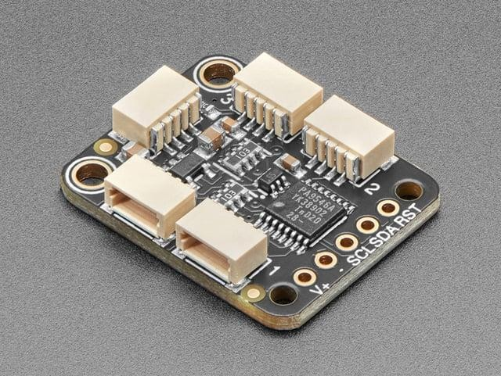
Sensors & Materials
[i]
[ii]
SparkFun Qwiic MicroPressure Sensor
Teensy 4.1
Sparkfun ICM-20948 9-dof IMU
[iii]
[iv]
[4]
Adafruit PCA9546
4-Channel Multiplexer
[4] Shoe Insole with Silicone tube coiled pressure pads placed at: [i] Toe [ii] Metatarsophalengeal 1-2 [iii] Metatarsophalengeal 3-4 [iv] Heel

Slide 10
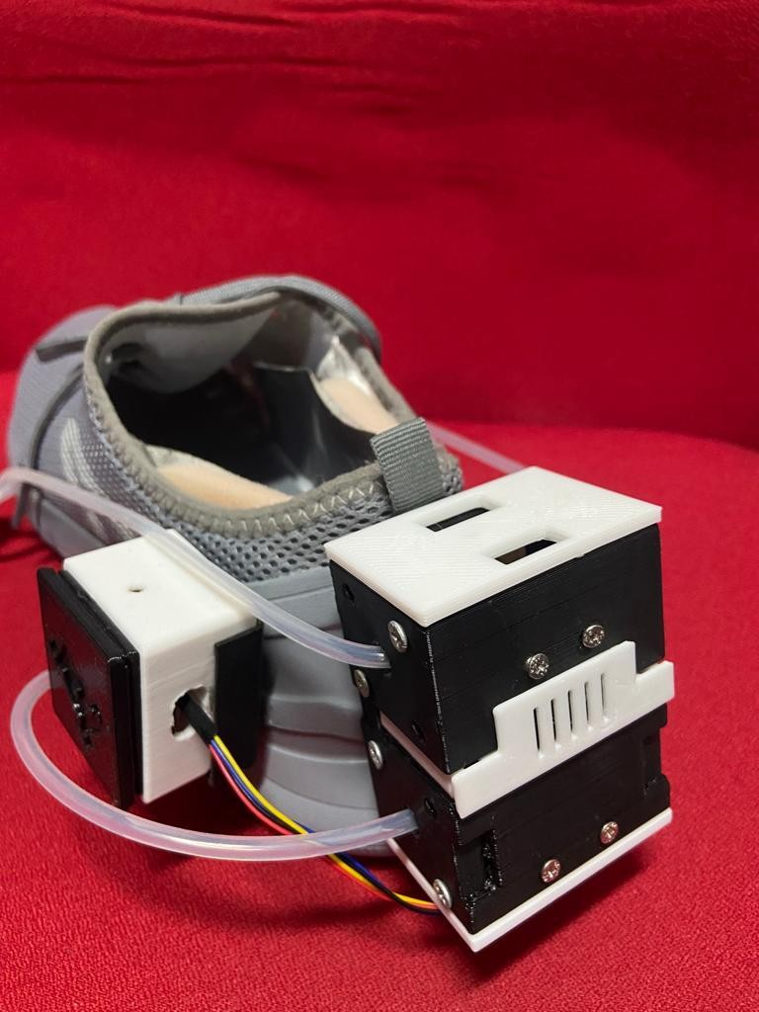
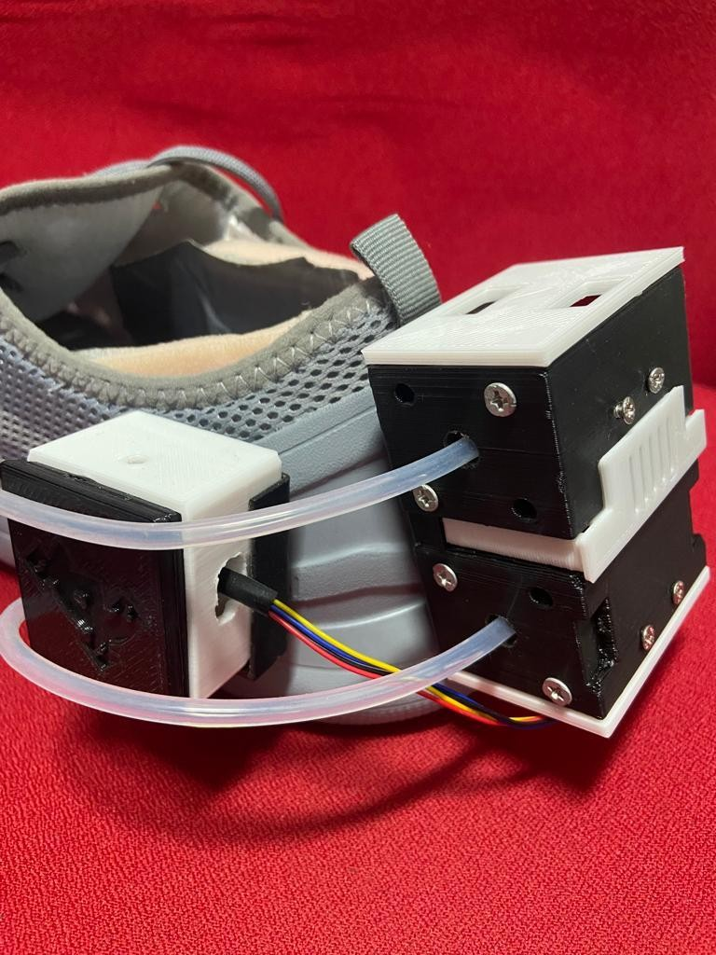
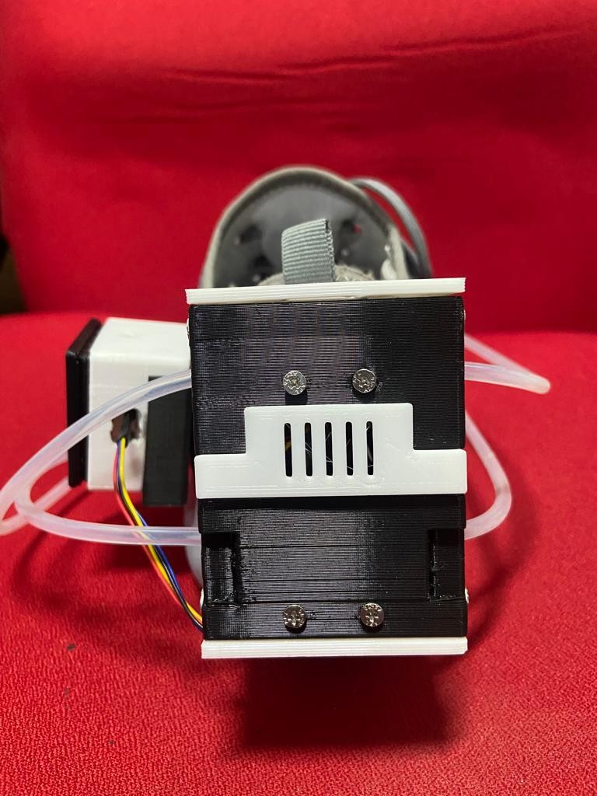
Experimental Design
Smart Shoe designed with 3D printed housing sensors to predict real time GRF

Slide 11
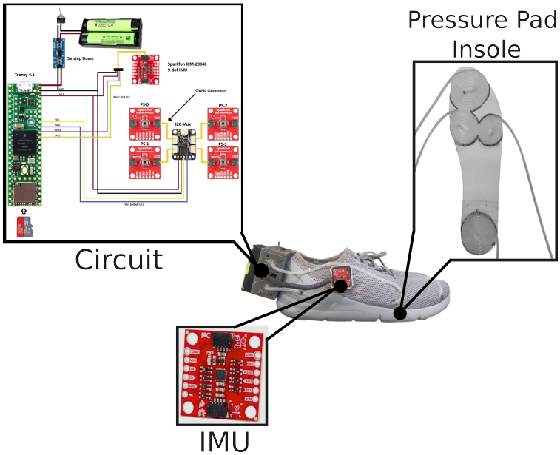
Experimental Design
Smart Shoe designed with 3D printed housing sensors to predict real time GRF

Slide 12
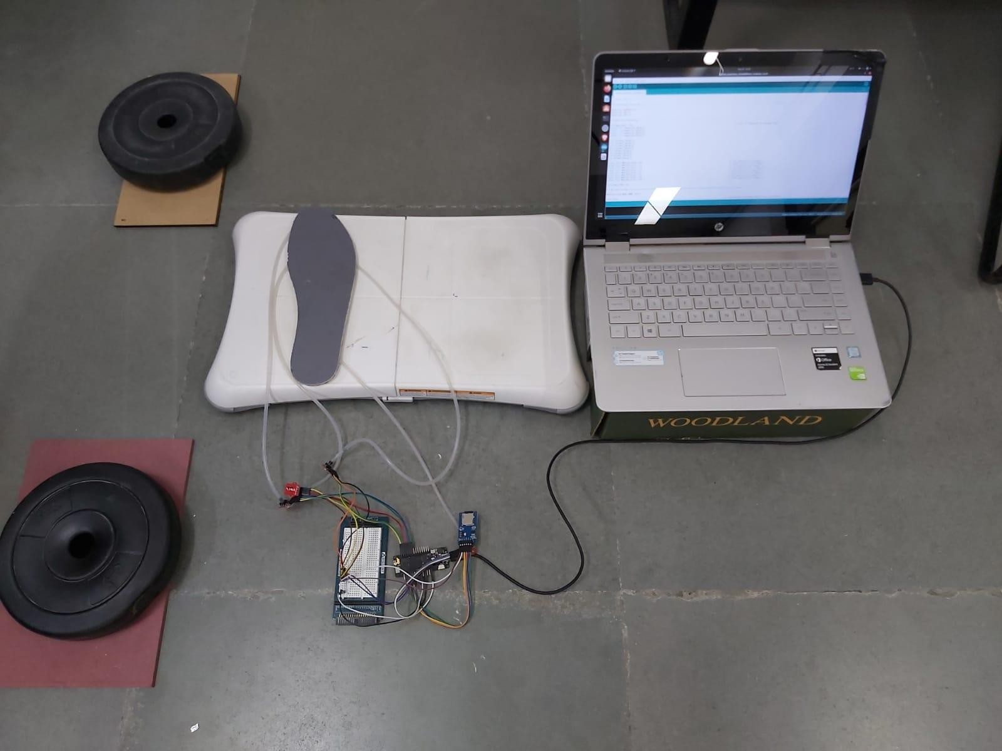

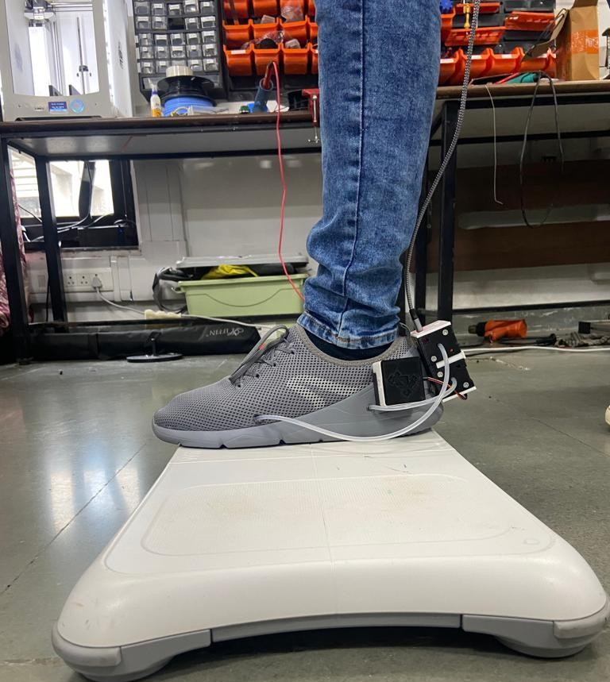
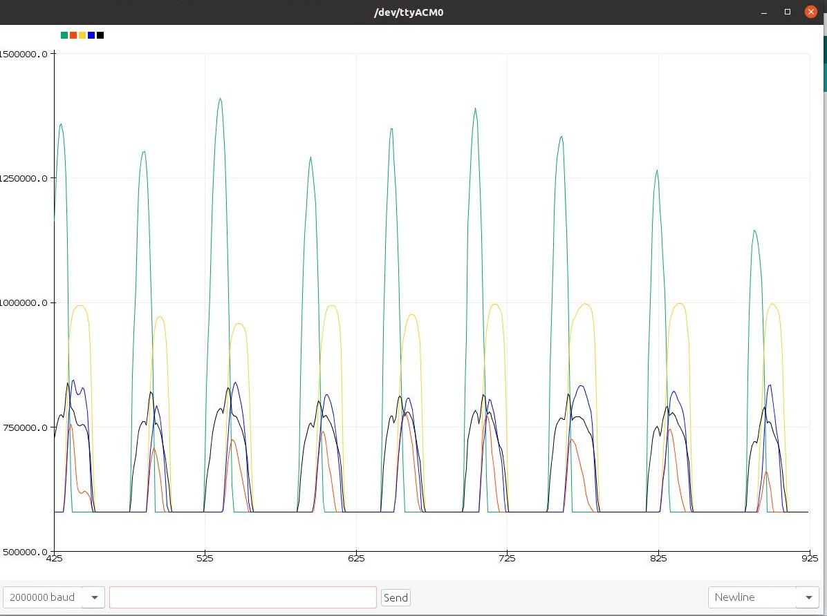
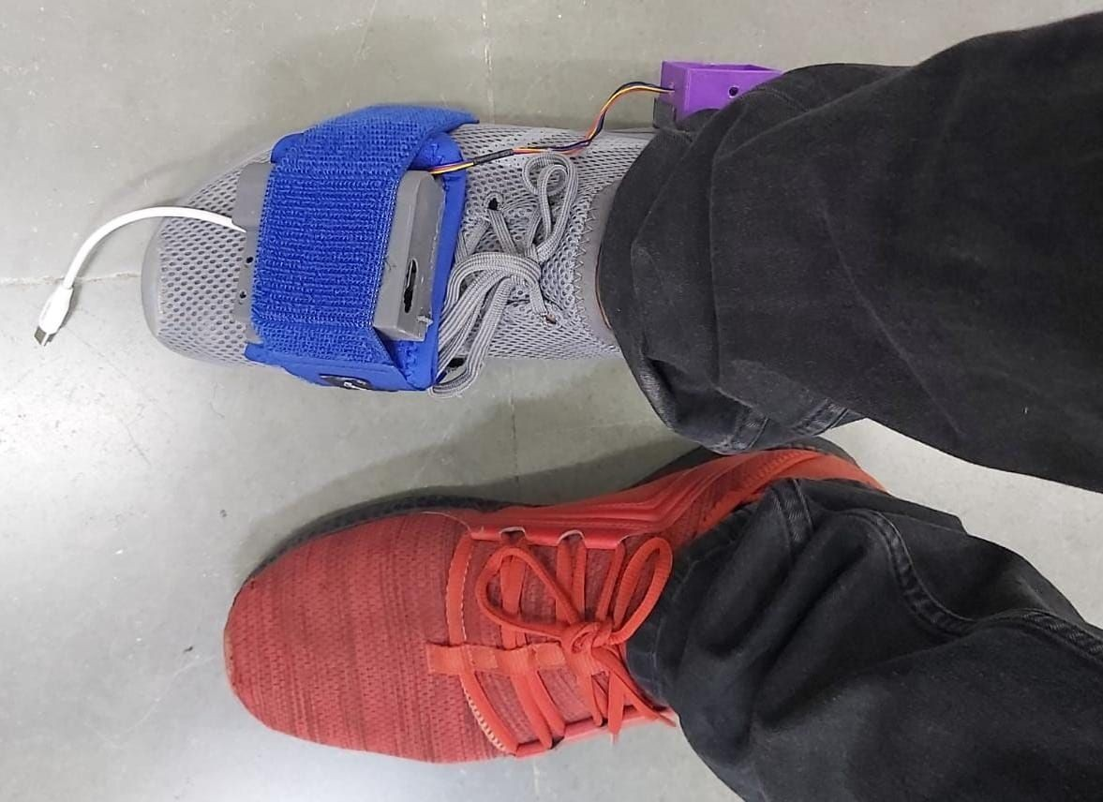
Data Collection
Before
Now
Indian Institute of Technology Gandhinagar

Slide 13
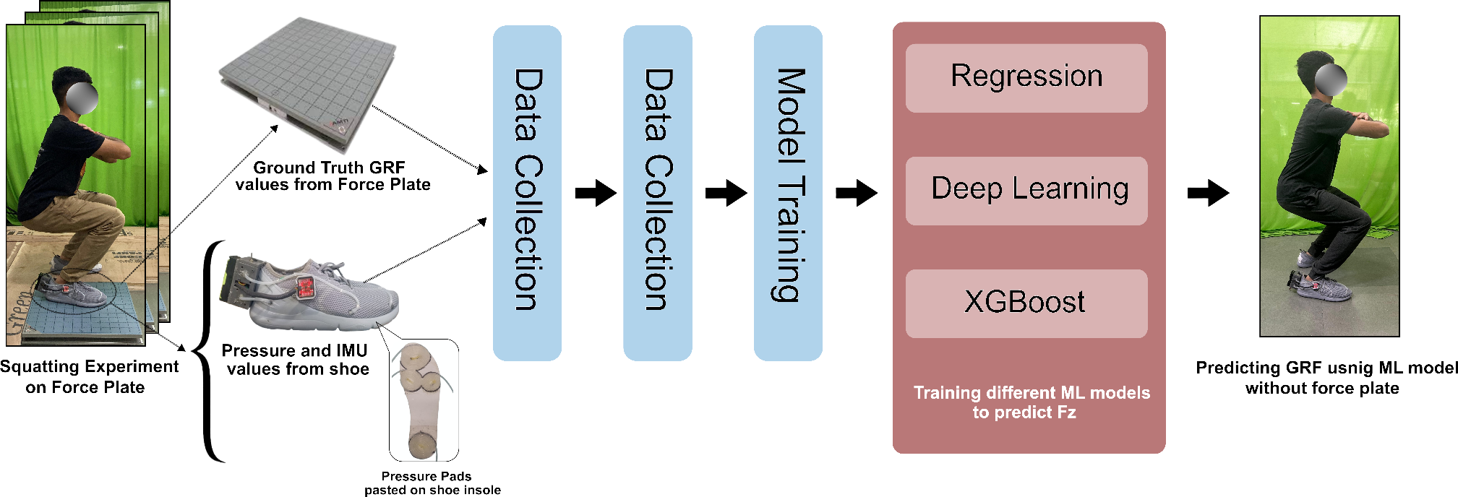
Workflow
Indian Institute of Technology Gandhinagar

Slide 14
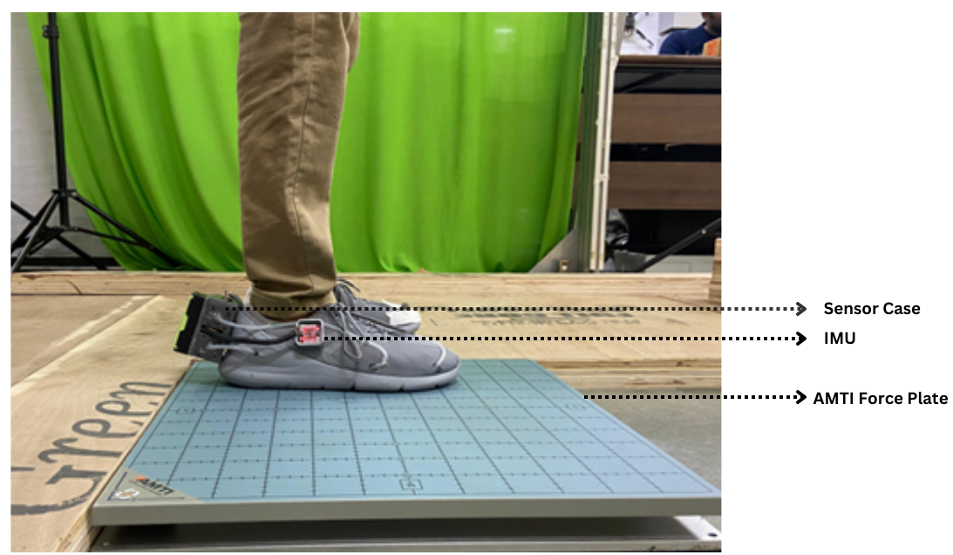

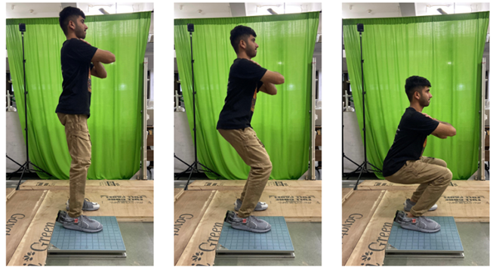
Data Collection
4 Subject Data Collected
3 bouts / speed
3 Different
trial
Experiments
Squatting Experiment
Indian Institute of Technology Gandhinagar

Slide 15
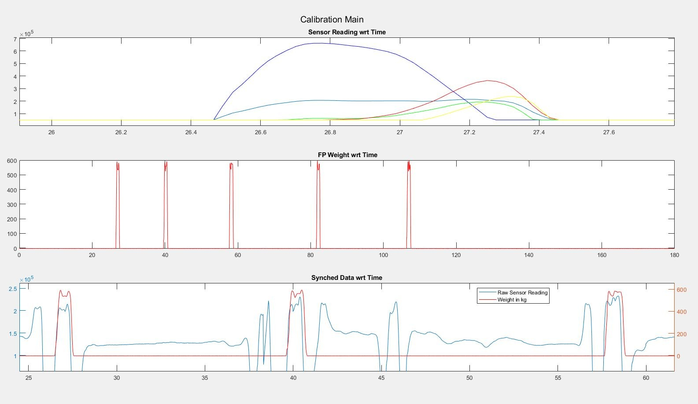
Data Synching & Calibration
Force Profiles
Force Plates
Smart Shoe
Similar Force Profiles obtained from Developed Smart Shoe and Force Plates

Slide 16
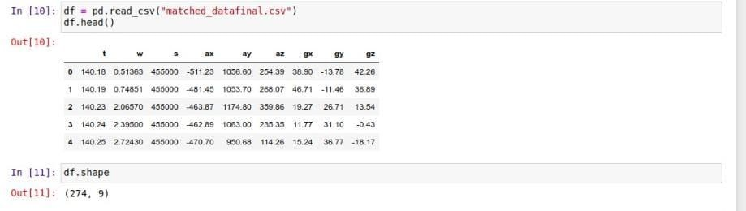
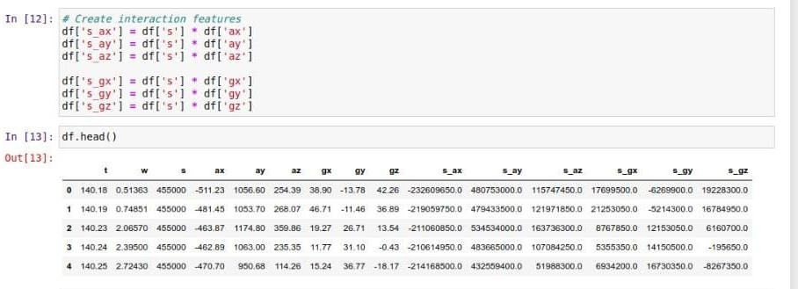
Data Visualization & Processing
Experiment Data Extraction from MATLAB
Importing Libraries, Loading Feature DataFrame
Normalizing Data and Creating Interaction Features
Indian Institute of Technology Gandhinagar

Slide 17
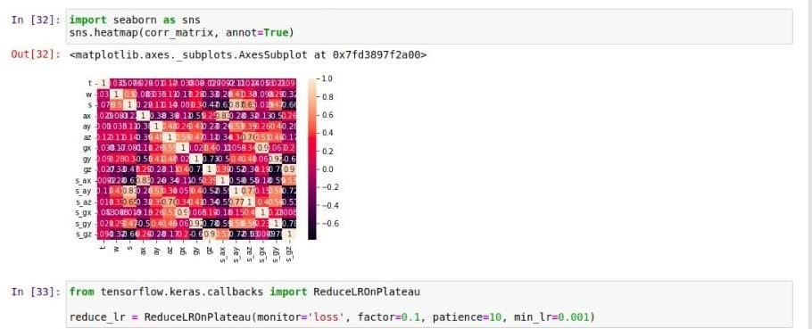
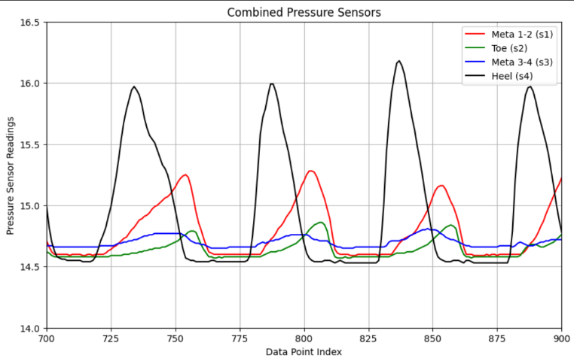
Visualizing Data, Outliers,
Distribution, Correlation Matrix
Splitting Data for Training and Testing
Model Training
Pressures sensor values during gait cycle
Indian Institute of Technology Gandhinagar

Slide 18
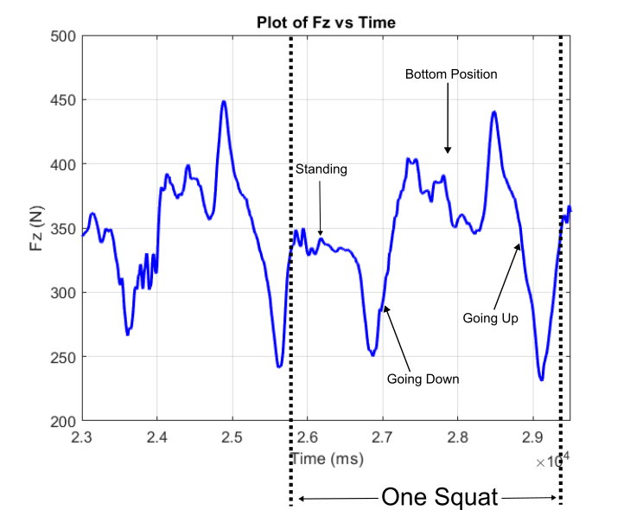
Squatting Data Visualization
Participant performing squat wearing the shoe sensor system
GRF in one squat cycle
Indian Institute of Technology Gandhinagar

Slide 19
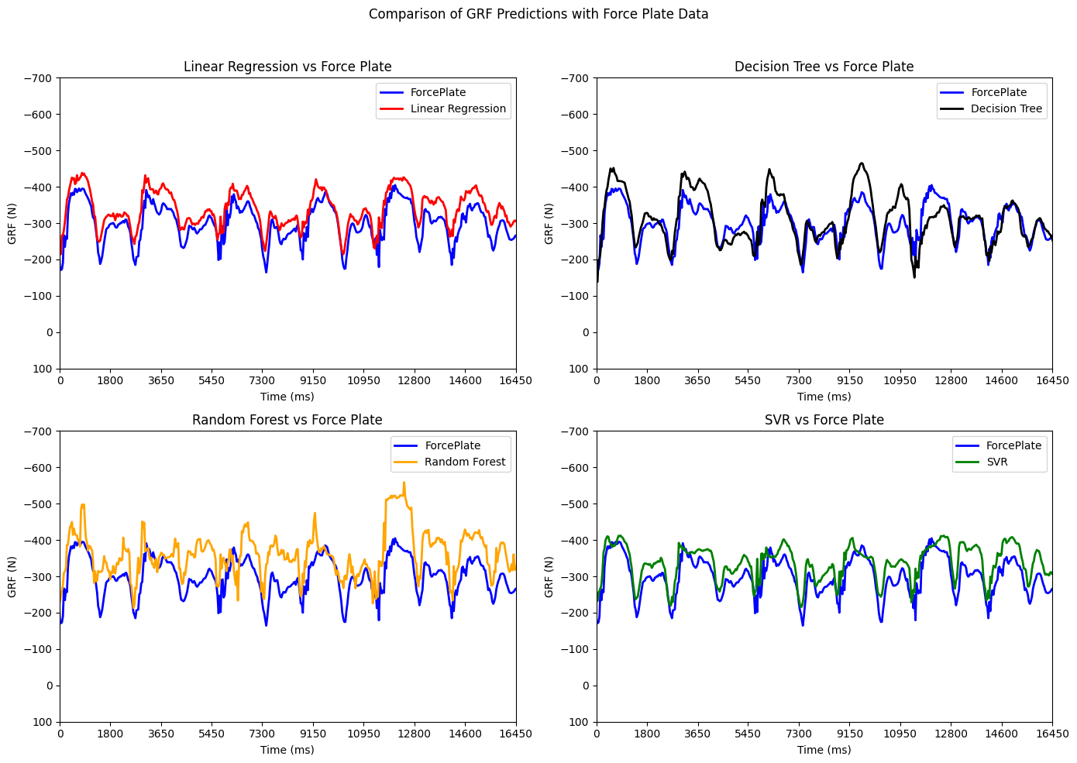
Model Outputs
Regression yielded promising results in capturing complex nonlinear patterns within the data.
The visualized data clearly distinguished squatting cycles.
Random Forest did not perform well, likely due to its need for a larger dataset.
Regression outputs for squatting experiment
Indian Institute of Technology Gandhinagar

Slide 20
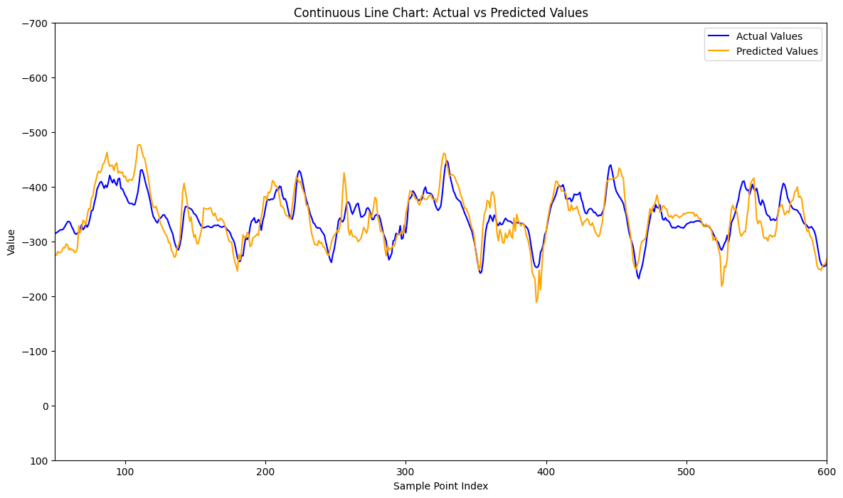
Model Outputs
Deep Learning performed well in minimizing the errors, also followed the patterns well.
The final deep learning model was a 3 dense layers with 128, 64, and 32 neurons each. This architecture implemented batch normalization, integrated L2regularization, used ReLU activation functions.
Deep Learning output for squatting experiment
Indian Institute of Technology Gandhinagar

Slide 21
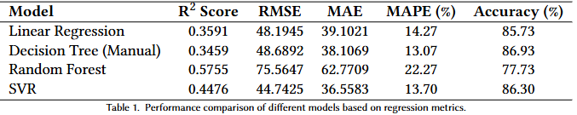
Model Outputs
Regression Performance values
Deep Learning Gave a promising maximum i.e. 91% accuracy on the squatting dataset.
Indian Institute of Technology Gandhinagar

Slide 22
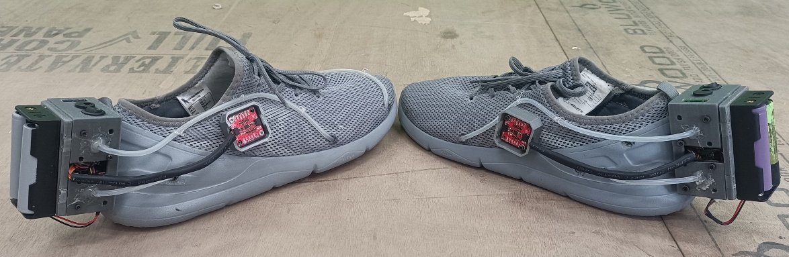
Second Shoe development
After successful trials on one shoe, development of another shoe started with same symmetric design making sure that both the pressure pads and pressure sensor values are same, and if they are not, what is the constant factor in their readings.
Both readings should be same because the model trained on one shoe should work for both shoe.
Indian Institute of Technology Gandhinagar

Slide 23
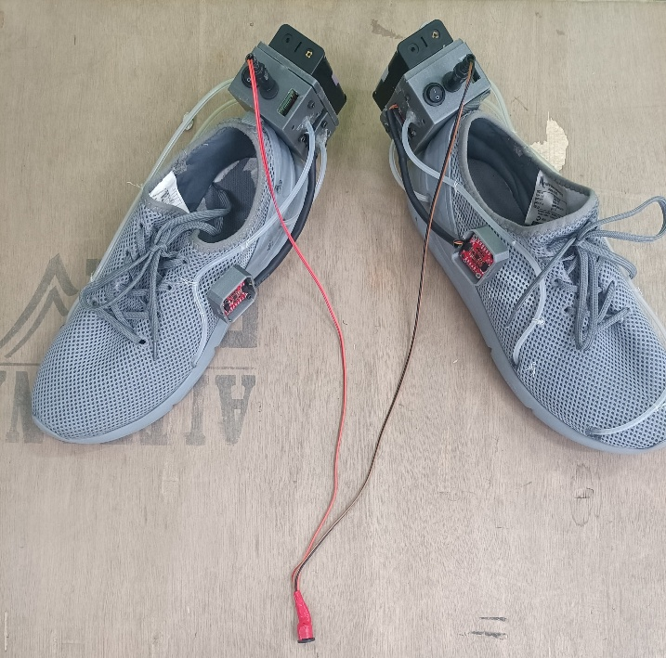
Data recording Synchronization
We used a trigger signal connected to both shoes via a Y-connector, generating a high pulse to initiate recording simultaneously. This ensured synchronized data collection, allowing us to use timestamps for precise data processing.
Trigger signal from force plates
Indian Institute of Technology Gandhinagar

Slide 24
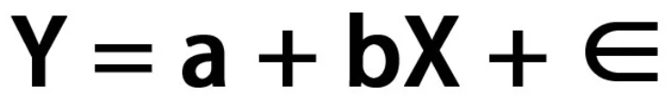

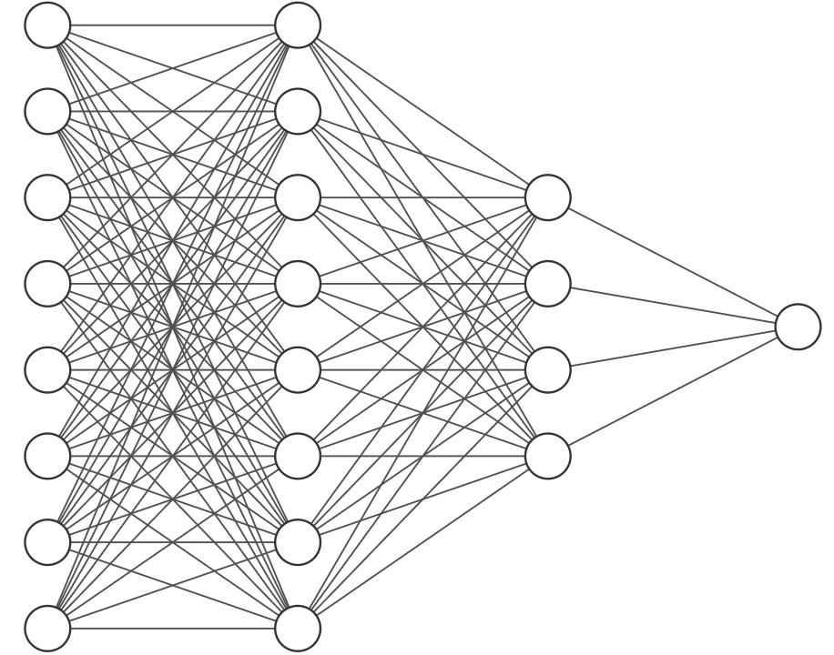
Next Steps
Collecting data for multiple activity protocol
(1 min standing, 1 min sitting, 1 min sit-to-stand, 1 min squatting)
Deploying Regression models directly on hardware to test real time processing.
Regression Parameters
Deep Learning Parameters
Teensy 4.1
Indian Institute of Technology Gandhinagar

Slide 25
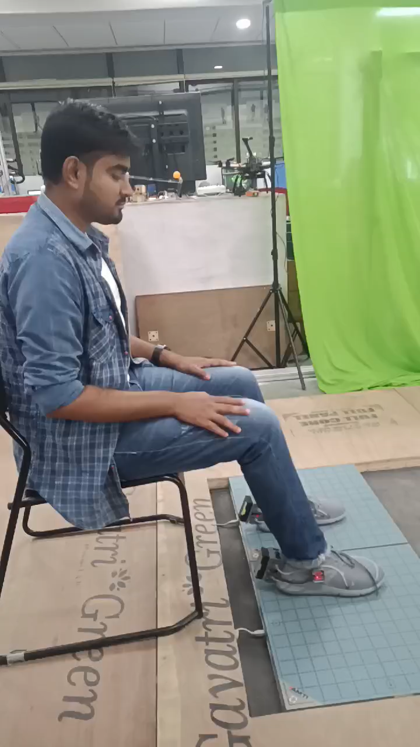
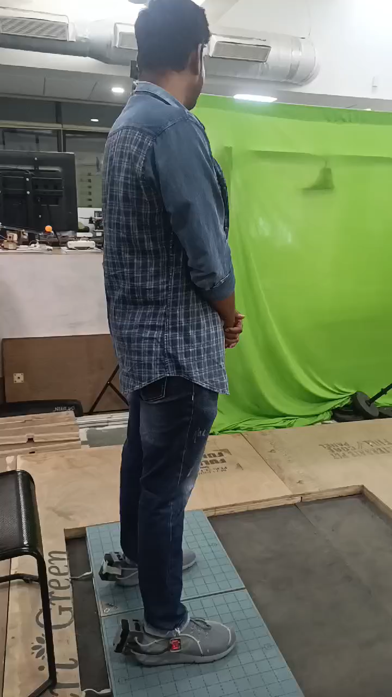
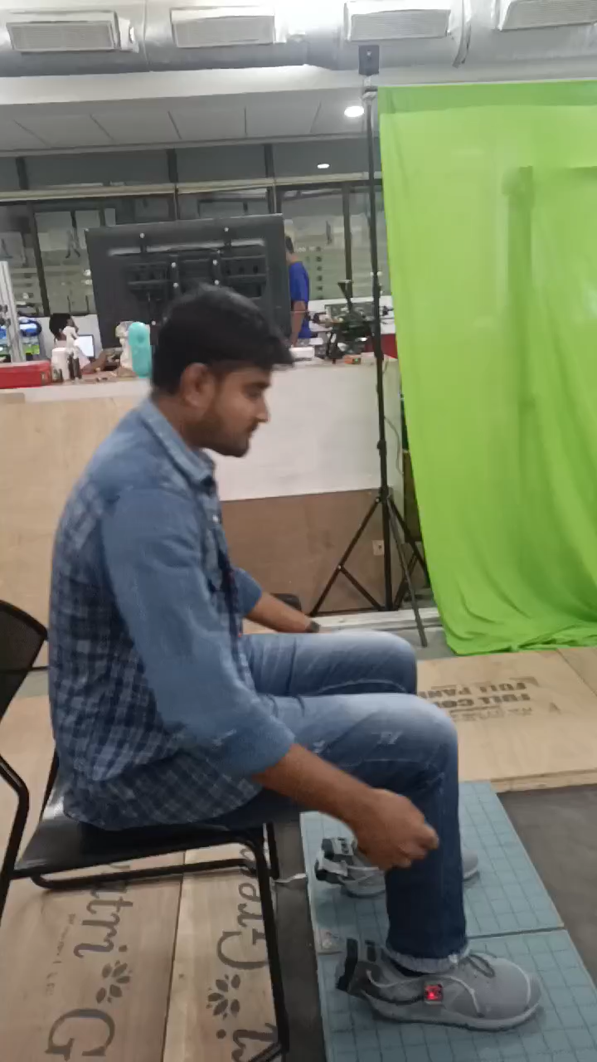
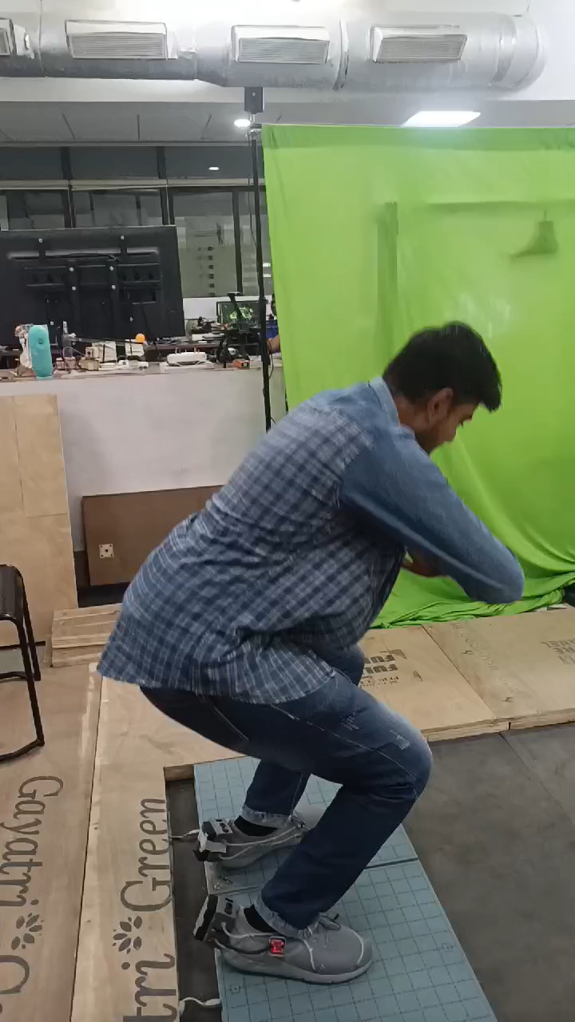
New Protocol
1 min Sitting
1 min Standing
1 min sit-to-stand
1 min Squatting
Indian Institute of Technology Gandhinagar

Slide 26
Thank You
Indian Institute of Technology Gandhinagar

